Slide 1


ASQL Project
Prepared by: Fery

Slide 2

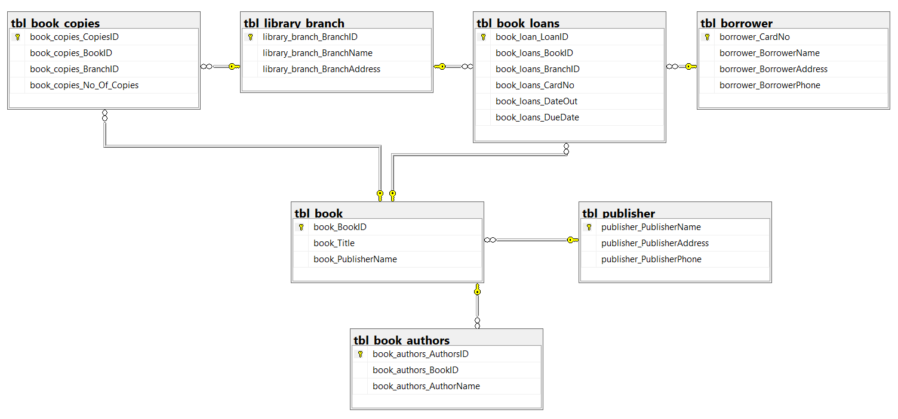

Slide 3
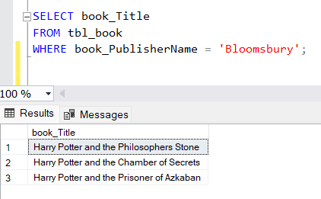
Q1. Find the titles of all books published by “Bloomsbury”.

Slide 4
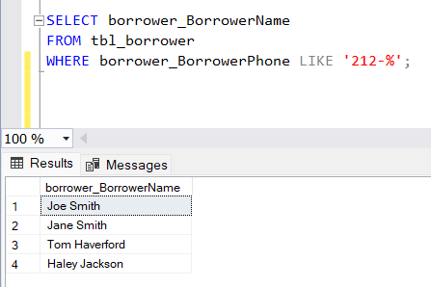
Q2. List the names of borrowers whose phone numbers start with the area code "212."

Slide 5
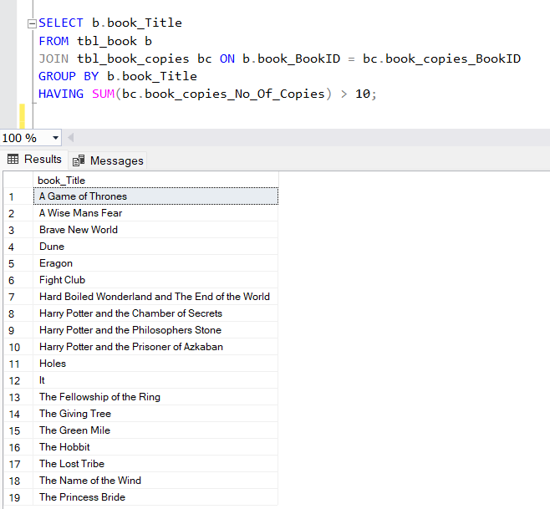
Q3. Retrieve the titles of books with more than 10 copies available.

Slide 6
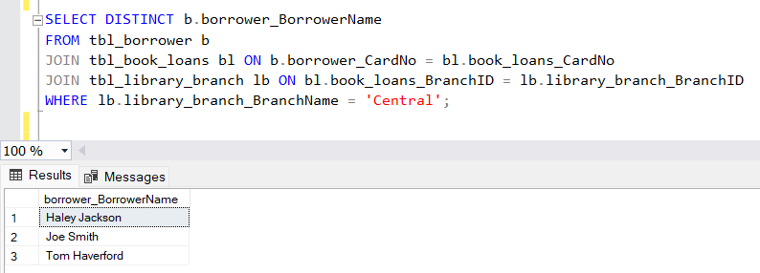
Q4. Display the names of borrowers who have borrowed books from the "Central" branch.

Slide 7
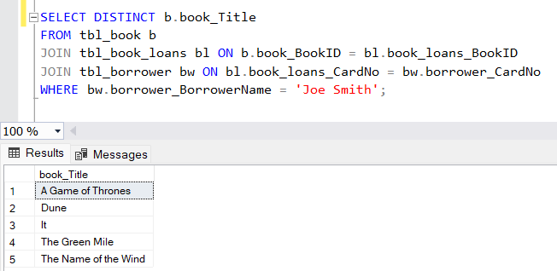
Q5.List the titles of books borrowed by borrower "Joe Smith."

Slide 8
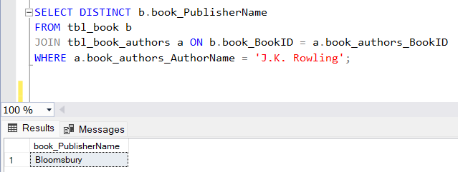
Q6. Find the names of publishers for the books authored by "J.K. Rowling."

Slide 9
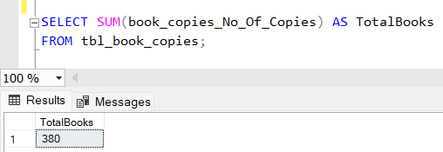
Q7. Count the total number of books available in the library.

Slide 10
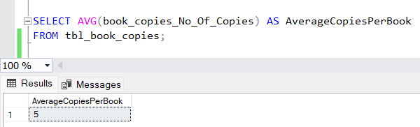
Q8. Calculate the average number of copies available per book across all branches.

Slide 11
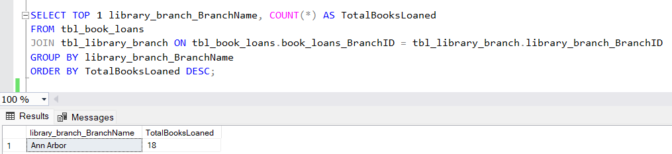
Q9.Find the branch with the highest number of books loaned out.

Slide 12
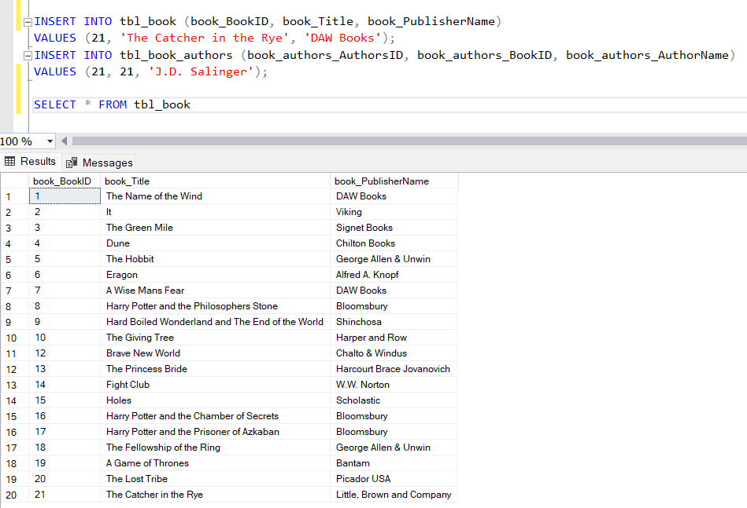
Q10.Insert a new book titled "The Catcher in the Rye" by "J.D. Salinger" into the database.

Slide 13
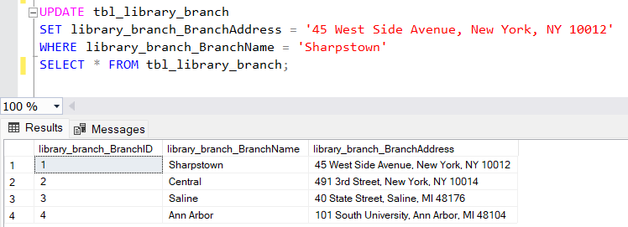
Q11. Update the address of the "Sharpstown" library branch to "45 West Side Avenue, New York, NY 10012."

Slide 14
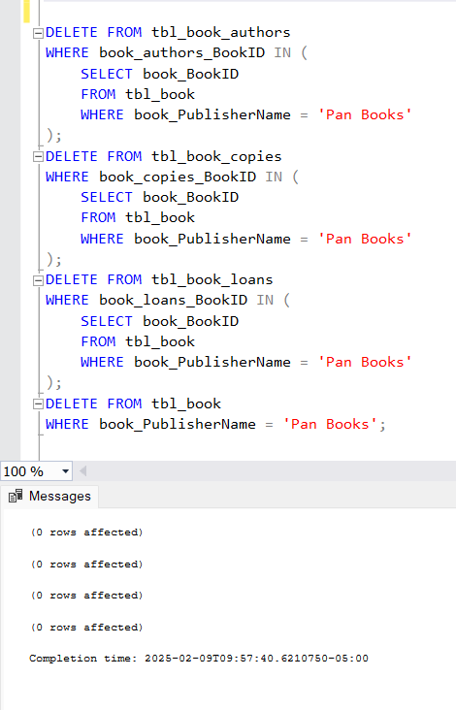
Q12. Remove all books published by "Pan Books" from the database.

Slide 15
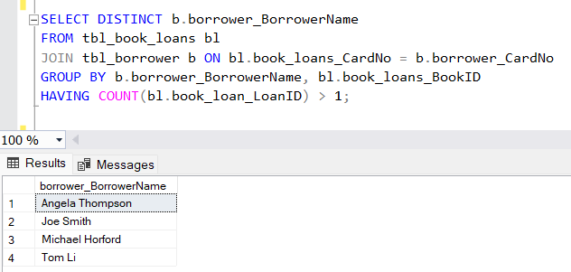
Q13. Retrieve the names of borrowers who have borrowed the same book more than once.

Slide 16
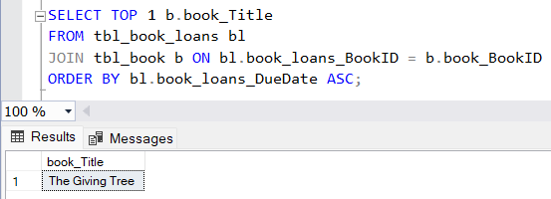
Q14. Find the title of the book with the earliest due date.

Slide 17
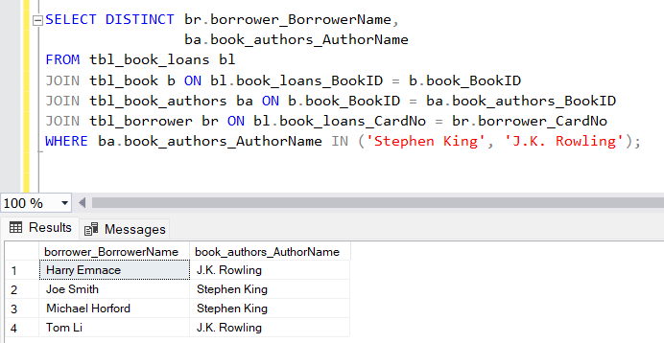
Q15.List the names of borrowers who have borrowed books authored by both "Stephen King" and "J.K. Rowling."

Slide 18
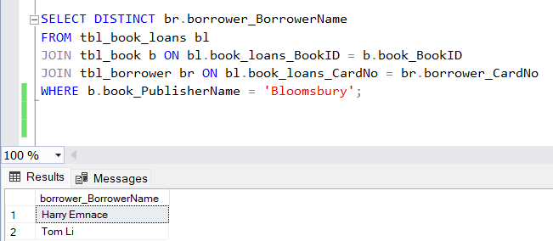
Q16. Find the names of borrowers who have borrowed books published by "Bloomsbury.

Slide 19
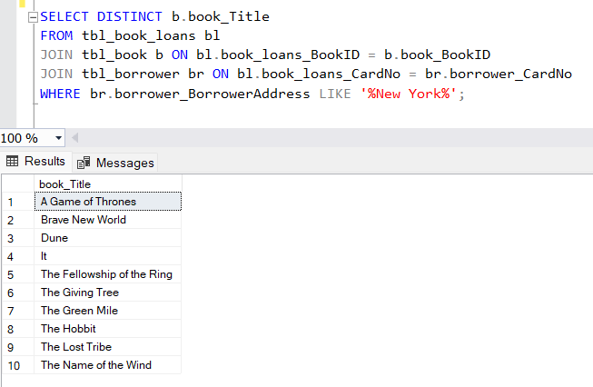
Q17. Retrieve the titles of books borrowed by borrowers located in New York.

Slide 20
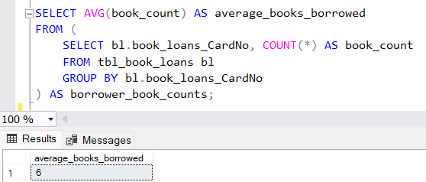
Q18. Calculate the average number of books borrowed per borrower.

Slide 21
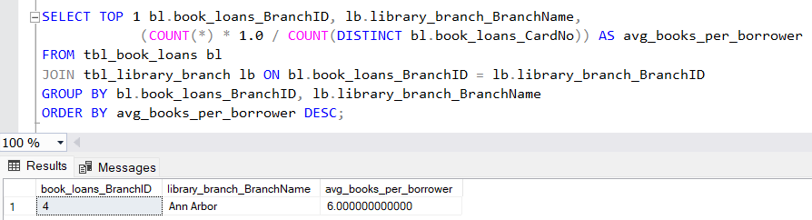
Q19.Find the branch with the highest average number of books borrowed per borrower.

Slide 22
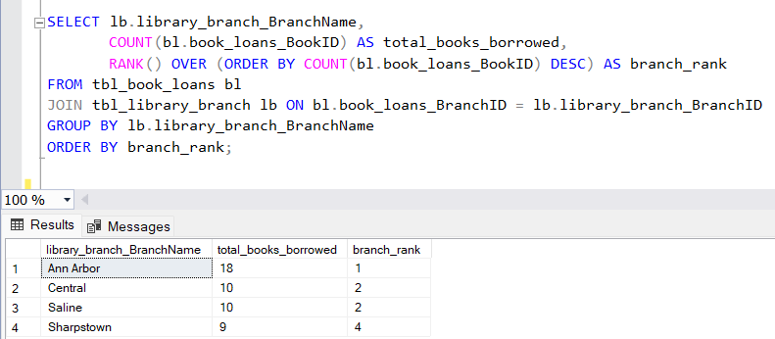
Q20. Rank library branches based on the total number of books borrowed, without grouping

Slide 23
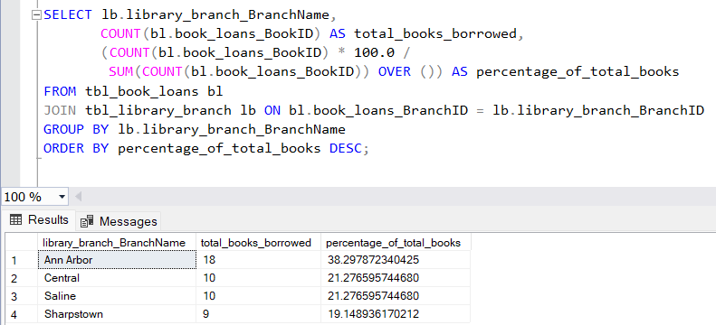
Q21. Calculate the percentage of books borrowed from each branch relative to the total number of books borrowed across all branches.

Slide 24
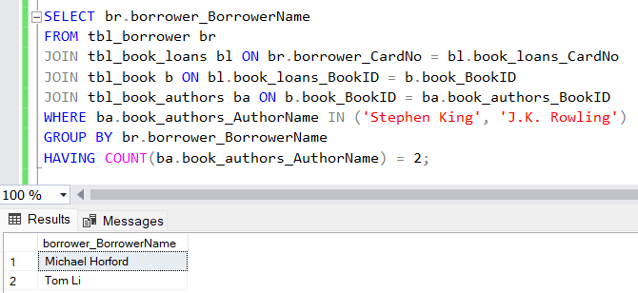
Q22. Find the names of borrowers who have borrowed books authored by "Stephen King" and "J.K. Rowling" from the same library branch.

Slide 25
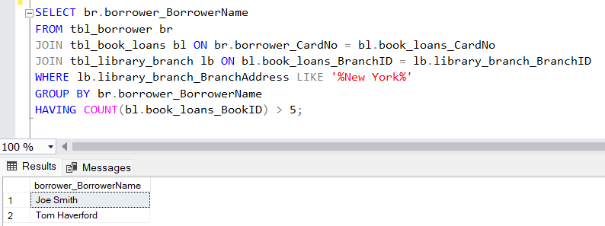
Q23. Retrieve the names of borrowers who have borrowed books from branches located in New York and have more than 5 books checked out.

Slide 26
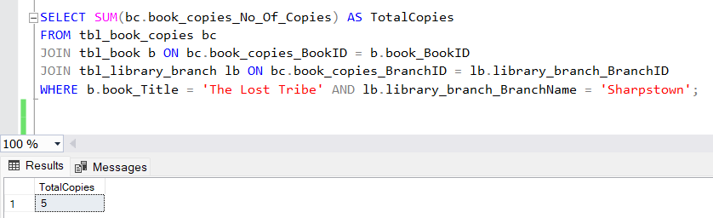
Q24. How many copies of the book titled "The Lost Tribe" are owned by the library branch whose name is "Sharpstown"?

Slide 27
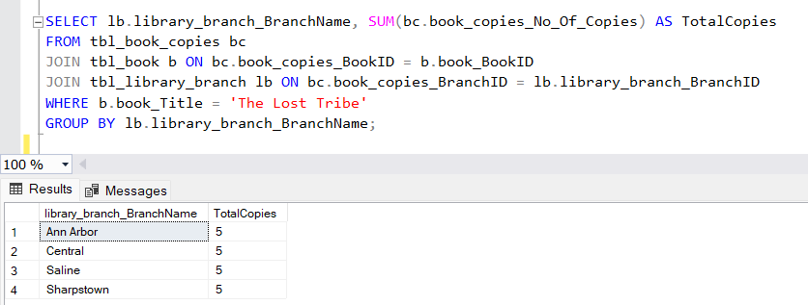
Q25. How many copies of the book titled "The Lost Tribe" are owned by each library branch?

Slide 28
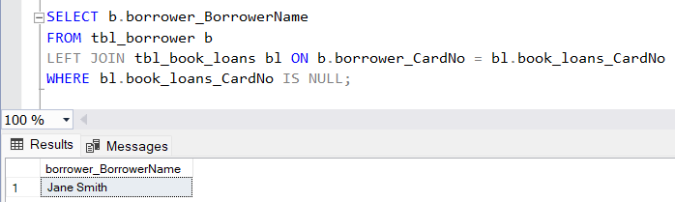
Q26. Retrieve the names of all borrowers who do not have any books checked out.

Slide 29
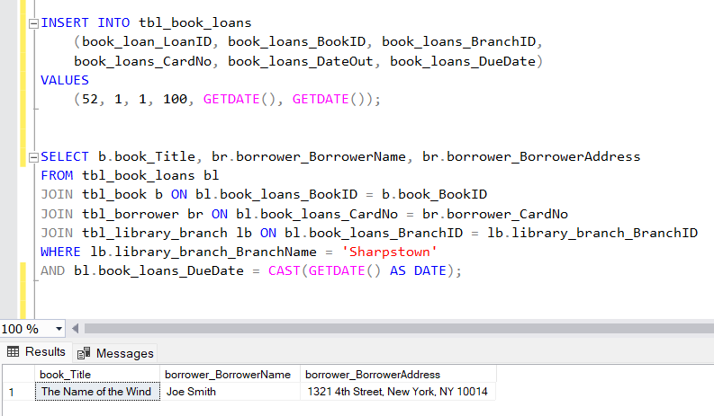
Q27. For each book that is loaned out from the "Sharpstown" branch and whose Due Date is today, retrieve the book title, the borrower's name, and the borrower's address.

Slide 30
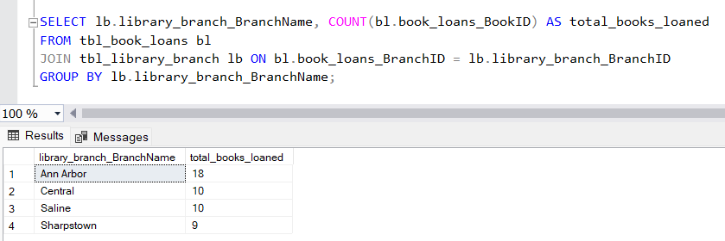
Q28. For each library branch, retrieve the branch name and the total number of books loaned out from that branch.

Slide 31
Thank you

